Slide 1


Predicting Customer Buying Behaviour
By Rahul Kumar

Slide 2
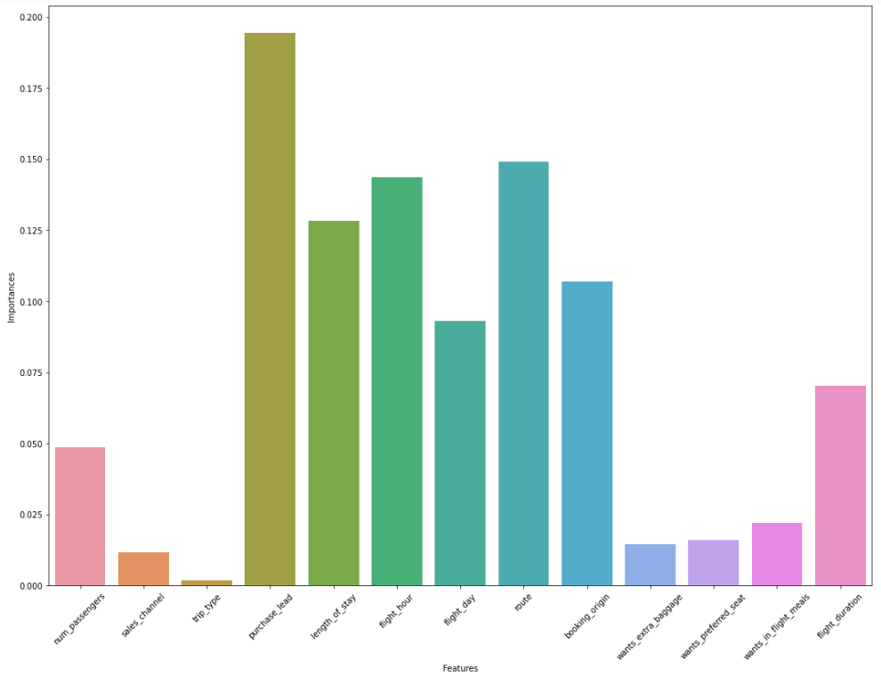
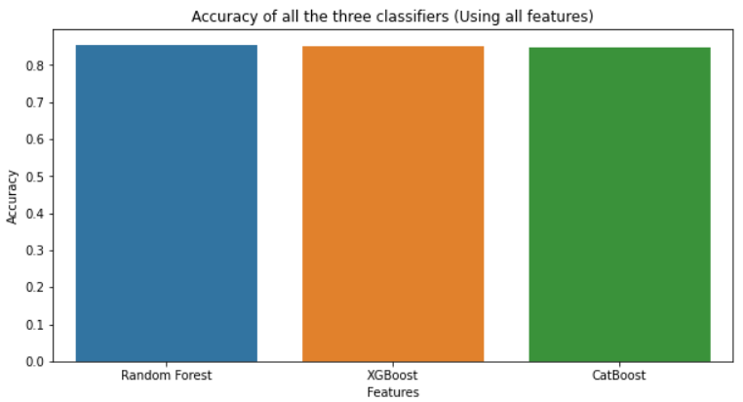
Prediction Model To Understand Factors
Influencing Buying Behavior
We have implemented three prediction model (Random Forest, XGBoost and CatBoost) using top-5 features and all features.
The Top 5 Features selected by ‘Random Forest’ method are:
1. purchase_lead , 2. route , 3. flight_hour, 4. length_of_stay & 5. booking_origin
Model | Accuracy | F1-score | ROC-AUC
Random Forest | 85.46% | 0.45% | 50%
XGBoost | 85.15% | 15% | 53.64%
CatBoost | 84.88% | 3.98% | 50.79%

